Slide 1

OGP
Update on South Africa’s Commitment One:
Transformative fiscal transparency
PRESENTED BY:
NAME: SEPHIRI
SURNAME: TLHOMELI
Title: DD
Division: LGBA
Date: 28 AUGUST 2024

Slide 2
Municipal Money Marketing
No | Type | Action | Frequency
1 | External Communications | Podcast (Maya on Money and Epokothweni - GoMuni) | Annually
 |  | Media Statements on GoMuni on quarterly S71 results | Quarterly
 |  | Webinar on Q4 S71 Outcomes | Annually
 |  | Links on relevant websites such as NT webpage | Ongoing
 |  | Exhibitions at large conferences | Quarterly
2 | Internal Communications | Email notification post- issuing of media statements.
 |  | Internal News in Brief (for benefit of all units of the National Treasury using LG financial data) | Monthly
3 | Guidance to use Municipal Money | Virtual training sessions Manual, videos (see next slide) Infographics on Municipal Money to simplify financial concepts | Ongoing

Slide 3
Municipal Money Marketing
No | Type | Action | Frequency
4 | Social Media – X, LinkedIn, Face Book | Social media banner on Gomuni & Mun Money Use hashtag #GoMuni #municipalportal Upload on YouTube & TikTok a video explaining how to use GoMuni portal Post Municipal Money snapshots and updates on published information Social media banners for webinars “Did You Know” social media banners about GoMuni & Mun Money | Weekly

Slide 4
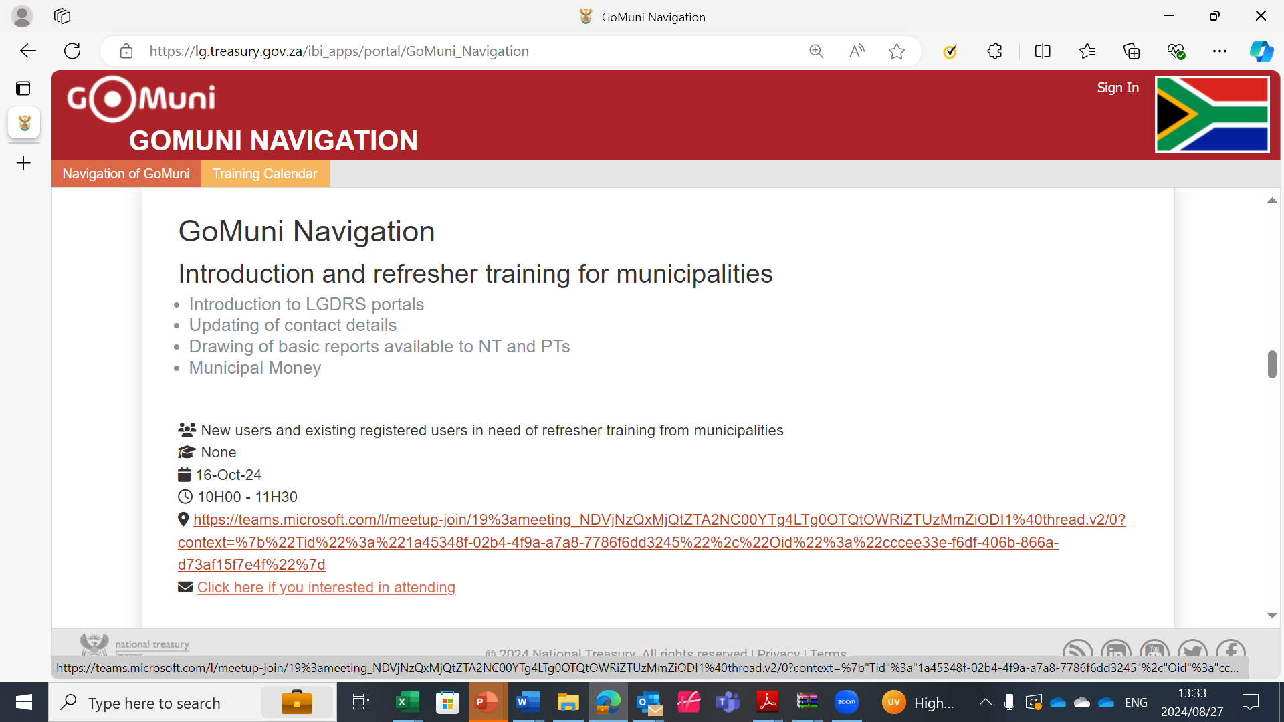
Municipal Money Marketing

Slide 5
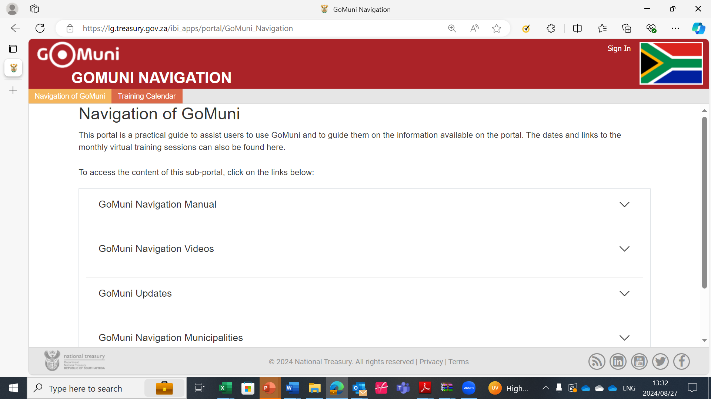
Municipal Money Marketing

Slide 6
Municipal Money Public Webinar
Webinar will focus on sharing the financial performance of municipalities as at the end of quarter 4 of the 2023/24 financial year – how does municipalities generate and spent their money
Proposed topics will include:
  Municipal spending trends
  Revenue collection, debtors and creditors management
  Performance of conditional grants
  Where can citizens find data to make informed decisions
Date: Planned for late September / early October 2024
NT is looking for a partner with a footprint on a public platform to assist with logistics – Any suggestions / volunteers?

Slide 7
THANK YOU

